Slide 1
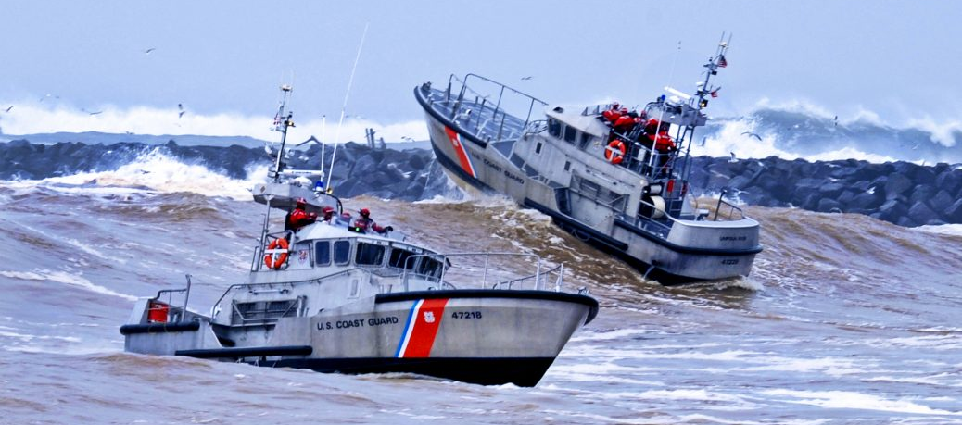
Unit Assessment
Notes:
Unit Assessment
A leadership tool used to assess the overall functioning of a unit.

Slide 2
Learning Objectives
Coast Guard Operational
Stress Control (CG -0SC )
EXPLAIN what a unit assessment is and the purpose of it
DISCUSS where a request and/or recommendation for a unit assessment comes from
IDENTIFY the six steps and DESCRIBE the process of a unit assessment
IDENTIFY tools used to conduct a unit assessment
IDENTIFY and DISCUSS what is included in a unit assessment summary report and leadership debrief
Notes:
Learning Objectives
EXPLAIN what a unit assessment is and the purpose of it
DISCUSS where a request and/or recommendation for a unit assessment comes from
IDENTIFY the six steps and DESCRIBE the process of a unit assessment
IDENTIFY tools used to conduct a unit assessment
IDENTIFY and DISCUSS what is included in a unit assessment summary report and leadership debrief

Slide 3
What is a Unit Assessment?
Coast Guard Operational
Stress Control (CG -0SC )
A leadership tool to evaluate the overall functioning and stress health of a unit
Where observable changes in function or statements of distress are apparent
Where there is a noticeable decrease in morale
During or after an accident or traumatic event
Notes:
What is a Unit Assessment?
A unit assessment is used as a foundation for providing actionable recommendations for leaders:
A leadership tool used to evaluate the overall functioning and stress health of a unit
Where observable changes in function or statements of distress are apparent
Where there is a noticeable decrease in morale in a unit
During/after an accident or traumatic event

Slide 4
Requests and Collaborations
Coast Guard Operational
Stress Control (CG -0SC )
Requests are activated by OSC unit leader or as a recommendation by command leadership
Expectation will be that unit leaders will discuss the request of a unit assessment with chain of command (COC) as appropriate
Service member(s) collaborate with unit assessment requester(s) to gather information and coordinate assessment
Transparency and active communication across multidisciplinary roles regarding individual and command challenges are essential for an effective unit assessment
Notes:
Requests and Collaborations
Requests are activated by unit leader (CO, DH, DO, LCPO) or as a recommendation by command leadership
Expectation will be that unit leaders will discuss the request of a unit assessment with chain of command (COC) as appropriate
Service Member(s) collaborate with Unit Assessment requester(s) to gather information to coordinate assessment
Transparency and active communication across multidisciplinary roles regarding individual and command challenges are essential for an effective unit assessment

Slide 5
Unit Assessment Steps
Coast Guard Operational
Stress Control (CG -0SC )
Step 1: Consult Leadership
Meet with unit/dept./etc. or command leadership on a unit assessment and the process
Step 2: Establish a Team
Establish an appropriate team to conduct the assessment
Step 3: Plan the Assessment
Plan and organize the assessment
Step 4: Conduct Assessment
Conduct interviews with identified focus groups utilizing predetermined questions
Step 5: Develop Report
Create a unit assessment summary report for leadership (requester)
Step 6: Leadership Debrief
Consult leadership (requester), provide feedback and recommendations
Notes:
Unit Assessment Steps
Step 1: Consult Leadership
Brief unit/dept./etc. or command leadership on a unit assessment and the process
Step 2: Establish a Team
Establish an appropriate team to conduct the assessment
Step 3: Plan the Assessment
Plan and organize the assessment
Step 4: Conduct Assessment
Conduct interviews with identified focus groups utilizing predetermined questions
Step 5: Develop Report
Create a unit assessment summary report for leadership (requester)
Step 6: Leadership Debrief
Consult leadership (requester), provide feedback and recommendations

Slide 6
Step 1: Consult Leadership
Coast Guard Operational
Stress Control (CG -0SC )
Brief leadership on a unit assessment and develop an understanding of the events, concerns, and expectations of the identified request:
Situation: What stimulated the request?
Identify factors leading up to request
Identify exposed and/or at risk personnel/unit
Leadership Activity: Previous and current leadership actions
Assess leadership actions based on Five Core Leader Functions (Strengthen, Mitigate, Identify, Treat & Reintegrate)
Provide Unit Assessment Trifold: Describes components and processes of conducting an assessment
Consider deploying Stress-o-Meter (SoM), or other surveys as indicated
Immediate Attention: Identify if any individual(s) need immediate attention
Clarify Expectations: What is the goal of the assessment?
Plan Assessment: Establish dates, times and focus groups to interview
Inform Personnel: Inform personnel on the assessment
Notes:
Step 1: Consult Leadership
Instructor Note:
-Review Unit Assessment trifold in student folder
Brief leadership on a unit assessment and develop an understanding of the events, concerns, and expectations of the identified request:
Situation: What stimulated the request?
Identify factors leading up to request
Identify exposed and/or at-risk personnel/unit
Leadership Activity: Previous and current leadership actions
Assess leadership actions based on Five Core Leader Functions (Strengthen, Mitigate, Identify, Treat & Reintegrate)
Provide Unit Assessment Trifold: Describes components and processes of conducting an assessment
Consider deploying Stress-o-Meter (SoM), or other surveys as indicated
Immediate Attention: Identify if any individual(s) need immediate attention
Clarify Expectations: What is the goal of the assessment?
Plan Assessment: Establish dates, times and focus groups to interview
Inform Personnel: Leadership should inform personnel on the assessment

Slide 7
Step 2: Establish a Team
Coast Guard Operational
Stress Control (CG -0SC )
Establish an appropriate team to conduct the assessment:
Having an experienced team leader to manage the assessment is highly encouraged
Multidisciplinary roles may be essential in conducting the assessment
Consider involving outside consultant/resource (CgOSC, EMH, FFSC)
Communicate role expectations
Deter individuals from participating who have a conflict of interest
Other potential internal sources to advise for support:
Medical/EMH
Chaplain
Notes:
Step 2: Establish a Team
Establish an appropriate team to conduct the assessment:
Having an experienced team leader to manage the assessment is highly encouraged
Multidisciplinary roles may be essential in conducting the assessment
Communicate role expectations
Deter individuals from participating who have a conflict of interest
Other potential internal sources to advise for support:
Medical
Chaplains

Slide 8
Step 3: Plan the Assessment
Coast Guard Operational
Stress Control (CG -0SC )
Plan and organize the assessment:
Confirm team, dates, times, location, and participants/focus groups to interview
Develop specific questions based on situation and interaction with requester AND/OR use standardized unit assessment questions as a guide
Consider internal/external resources (as needed)
Notes:
Step 3: Plan the Assessment
Plan and organize the assessment:
Confirm team, dates, times, location, and participants/focus groups to interview
Develop specific questions based on situation and interaction with requester AND/OR use standardized unit assessment questions as a guide
Consider internal/external resources (as needed)

Slide 9
Step 4: Conduct Assessment
Coast Guard Operational
Stress Control (CG -0SC )
Introduce team involved in the unit assessment
Explain what a unit assessment is and the purpose of it
State who has requested it
Be clear on the goals of the assessment and the limits of your role
Identify what information will be reported and to whom
Identify limits of confidentiality: CMEO, DAPA, SAPR, and Legal all have separate confidentiality processes
Ask predeveloped questionnaire and document all responses
Ask if there are any (peers, units, sections) that they are particularly concerned with
Consider buddy care and self care strategies as indicated
Provide summation, ask if you missed anything and provide feedback
Notes:
Step 4: Conduct Assessment
Instructor Note:
-Review predeveloped sample questions in student folder
Conduct the Assessment:
Introduce team involved in the unit assessment
Explain what a unit assessment is and the purpose of it
State who has requested it
Be clear on the goals of the assessment and the limits of your role
Full disclosure and transparency to all participants on the unit assessment process is key
Identify what information will be reported and to whom
Identify limits of confidentiality: CMEO, DAPA, SAPR, and Legal all have separate confidentiality processes
Ask predeveloped questionnaire and document all responses
Ask if there are any (peers, units, sections) that they are particularly concerned with
Consider buddy care and self care strategies as indicated
Provide summation, ask if you missed anything and provide feedback

Slide 10
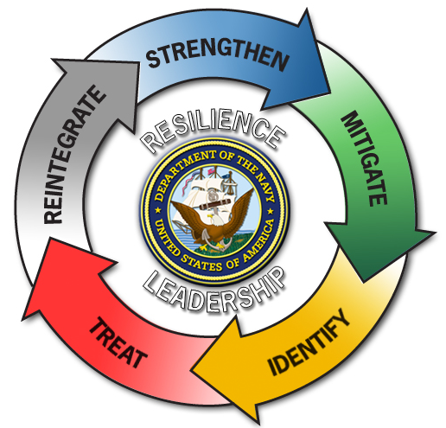
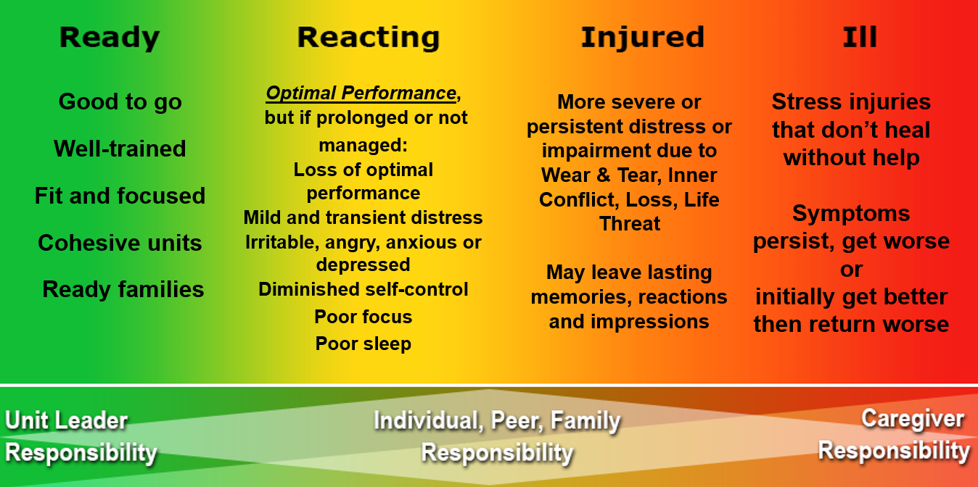
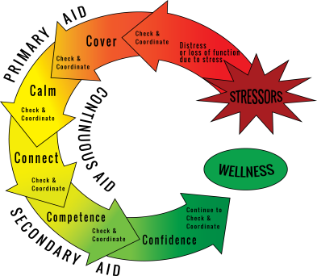
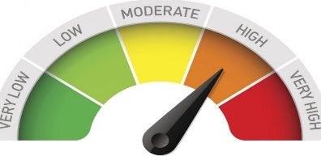
Tools to Use
Coast Guard Operational
Stress Control (CG -0SC )
Stress Continuum
Model
Core Leader
Functions
Combat & Operational
Stress First Aid (COSFA)
Total Force Wellness Profiler
Notes:
Tools To Use
Core Leader Functions: The Core Leader Functions were developed to reinforce a leader’s commitment to sailors, families and overall command psychological health. The following are action elements for leaders to use to manage an environment conducive to dealing with operational stress and to develop resilience – strengthen, mitigate, identify, treat and reintegrate.
Stress Continuum Model: The Stress Continuum Model is a spectrum of stress responses categorized in four zones identifying stress responses: Green “Ready” zone, Yellow “Reacting” zone, Orange “Injury” zone and Red “Illness” zone. It is a tool and is a common language that allows us to identify, engage and intervene when stress reactions or injuries are present.
Stress-o-Meter (SoM): is a web-based tool developed to provide a confidential real- time “snapshot’ of the stress level for command personnel. The Stress-o-Meter collects subjective information based on the Stress Continuum and creates a “dashboard” for command leadership. This “dashboard” illustrates the “temperature” of the command, Directorate, or Department, etc. to assist leaders with understanding staff stress levels and to determine if there is a need for an intervention.
Combat & Operational Stress First Aid (COSFA): is a flexible multi-step process for the timely assessment and preclinical care of psychological stress injuries in individuals or units with the goals to preserve life, prevent further harm and promote recovery. The action steps of COSFA are - check, coordinate, cover, calm, connect, competence and confidence.

Slide 11
Step 5: Develop Report
Coast Guard Operational
Stress Control (CG -0SC )
State the background, purpose & general demographics (consider confidentiality)
Describe the process used by the unit assessment team
Summarize the findings by source of injury, key themes, focus group, strengths and vulnerabilities
Provide general comments with major concerns using “sources of injury”
Offer recommendations using the Core Leader Functions (Strengthen, Mitigate, Identify, Treat, Reintegrate)
State final remarks
Recommend a follow-up assessment
Notes:
Step 5: Develop Report
Instructor Note:
-Review sample report(s) in student folder
Develop a report:
State the background, purpose & general demographics (consider confidentiality)
Describe the process used by the unit assessment team
Summarize the findings by source of injury, key themes, focus group, strengths and vulnerabilities: You are NOT going to tell them how to fix it, but provide information to command to make decisions
Provide general comments with major concerns using “sources of injury”
Offer recommendations using the Core Leader Functions (Strengthen, Mitigate, Identify, Treat, Reintegrate)
State final remarks
Recommend a follow-up assessment

Slide 12
Step 6: Leadership Debrief
Coast Guard Operational
Stress Control (CG -0SC )
Provide report and debrief findings to appropriate levels of leadership
Offer feedback and recommendations
Recommend resources for support
Determine follow-on plan (SoM, Buddy Care, Training(s))
Schedule a follow-up assessment
Offer consultation (as needed)
Notes:
Step 6: Leadership Debrief
Debrief findings:
Provide report and debrief findings to appropriate levels of leadership
Offer feedback and recommendations
Recommend resources for support
Determine follow-on plan (SoM, Buddy Care, Training(s))
Schedule a follow-up assessment
Offer consultation (as needed)

Slide 13
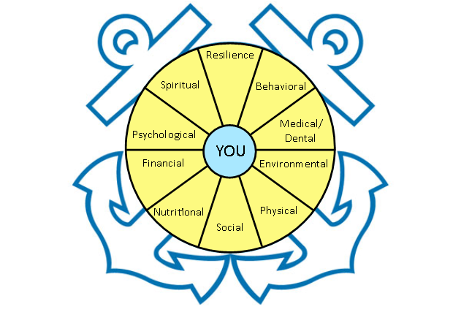
Coast Guard Operational
Stress Control (CG -0SC )

Slide 14
How the TFWP Works
Readiness? You or Unit
Contact EAP or HPM for URL
Evaluate, Take Action
Take Assessment

Slide 15
Members will receive an anonymous personal report
Leadership can evaluate how to improve resources to both commands and units.
Commands will receive an aggregate report on the climate of the unit.
Notes:
Leadership is essential in achieving total wellness—we model and modify the behavior we wish to see! We provide permission, even tacit, for people to do what they need to take good care of themselves.
Commands will get an aggregate report on how their unit did. The Employee Assistance Program Coordinators work with commands to make any improvements. Leadership will evaluate the data to determine if like units have similar high scores, (Ships, air stations small boar units) or if certain areas (Kodiak, Florida) have similar high scores. This will help the CG coordinate resources and training where it is needed.
Strategies should also address eliminating the stigma and other factors that prevent Service members (and their families) from seeking help early and focus
on achieving increased performance. These strategies should equip our people with the tools and skills required to continually assess and adjust or calibrate,
their environment, allowing them to maintain the necessary balance of intellectual skill, physical endurance and emotional stamina needed to carry
out missions.

Slide 16
<Unit Name>
Notes:
Physical fitness is a fundamental element of one's physical and mental health, mission performance, and readiness. By integrating physical fitness
into the other seven domains of TFF, Service members and their families can prepare themselves for the intensity of today's operational demands.
A well-rounded physical fitness program should include varied cardio training: balanced strength training that includes core strengthening exercises, flexibility, speed, and agility training; appropriate amounts of sleep and recovery; and effective mind-body programs, such as yoga, martial arts, and meditation.
These stressors include physical (temperature, altitude, noise, air quality, and radiation); biological (food, water, and vector-borne disease); and chemical (food, water, and occupational and environmental contaminants).
Varied environmental conditions may require specific physiological and behavioral adaptations as well as personal protective equipment and training to
achieve or sustain optimal environmental fitness. Understanding the environmental component of TFF will equip leaders with the training and skills needed to optimize human performance and military effectiveness.
Medical and dental fitness components are Service and individual specific but generally encompass the following:
a. Screening for overall wellness. diseases. physical and duty limiting
conditions. and behavioral and disease risk factors.
b. Immunizations to assist in mitigating or eliminating future risk to Service
members and optimizing success during training and on the battlefield.
c. Prevention and pretreatment against disease and injury by implementing
strategies that cannot be accomplished through wellness or immunization.
d. Medical conditions related to dental. vision. and auditory health is
critical to individual readiness and is often a potential marker for underlying
physical illness.
The goal of nutritional fitness is to achieve optimal health and performance. Our leaders, Service members, and their families must be taught how to promote, implement, achieve. and maintain healthy eating behaviors and to create an environment that makes healthy food and beverage options an easy and appealing choice.
Spiritual fitness includes an individual's or group's ability to maintain beliefs, principles, and values needed to provide support in times of stress.
Spiritual fitness includes the development of personal qualities needed to sustain a person in times of stress, hardship. and tragedy. These personal
qualities may come from religious, philosophical, or human values and form the basis for character, disposition, decision making, and integrity. Human
spirit development provides people with an understanding of who they are in terms of core values and identity. This awareness contributes to consistent
behavior in accordance with one's values and identity and living with integrity.
Psychological fitness includes the integration and optimization of mental, emotional, and behavioral abilities and capacities to optimize performance and
strengthen resilience.
Resilience Given the current demands placed on our forces. a Service member's resilience -- ability to withstand, recover, grow, and adapt under challenging
circumstances -- is vital to readiness and mission accomplishment. Without resilience, Service members and their families are at risk of burnout, psychological stress, and physical danger due to impaired functional abilities.
Behavioral fitness includes the ability to adopt behaviors that support individual readiness and health. Behavioral health refers to the integration
and optimization between one's behaviors and positive or negative health outcomes. A high degree of behavioral fitness highlights the importance of
individual responsibility and leader awareness to help shape healthy behaviors. Behavioral fitness is not simply about avoiding negative behavior; it is also
about supporting and affirming positive behavior. The success of reinforcing positive behavior lies in positive examples and continuous feedback by leaders
and is crucial to preventing risky behavior that adversely affects the health of Service members and families.
Social fitness includes the ability to engage in healthy social networks that promote overall well-being and optimal unit performance. Org fitness is characterized as the healthy connections within the social network of the unit structure for overall well-being and optimal unit performance.
Financial--$$$$

Slide 17
Notes:
Give leaders the tools to know when to intervene.
Provides guidance and support they need.
Continue to promote healthy lifestyles, optimize safety and healthy working conditions, facilitate access to health care, and conduct periodic health assessments.

